Slide 1

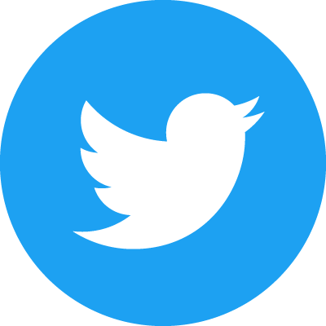
From Me to Team
Photo by Héctor J. Rivas on Unsplash
Learning to code collaboratively
Victoria King
@victoriaj_king
Notes:
Thanks for the introduction Izzy, and thank you all for attending ☺

Slide 2
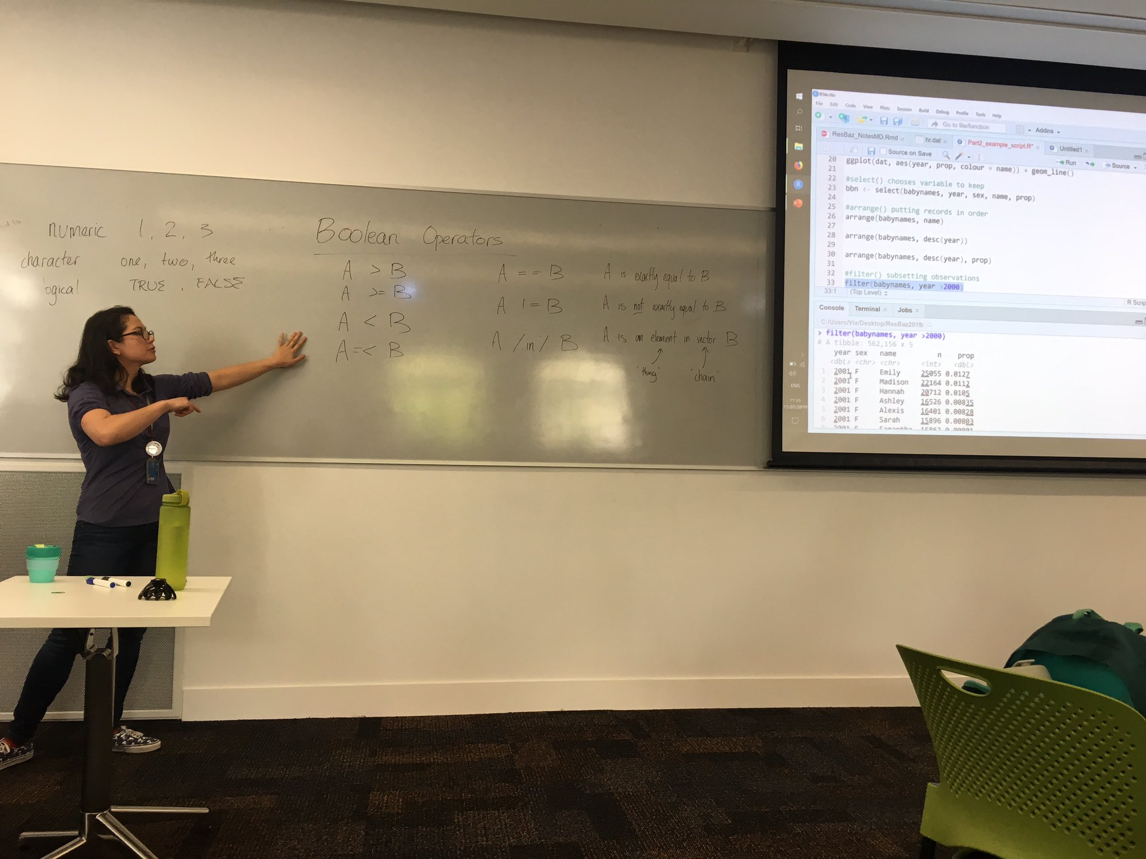
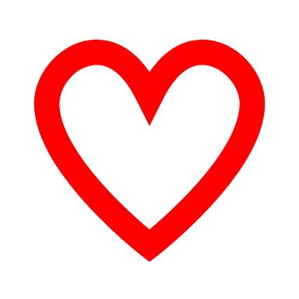
I’m a
PhD student
Scientist-in-training
Graduate TA
Self-taught R student
Coffee fiend
Hi! I’m Vix.
Notes:
Hi, I’m Vix. I’m a third year PhD student. I study fetal physiology at the University of Auckland, with a particular focus on the detection of fetal distress in growth restriction during late gestation pregnancy. I’m also a graduate teaching assistant, a self-taught R student, and I really like coffee ☺
I’ll preface everything by saying that the end of my third year of PhD study is the end of this month; this means I have less than a year to complete everything, and I am rapidly burning that candle. I thought I might botch a super technical talk at this point, and I thought maybe a more high-level talk might fly with more people anyway. In any case – hopefully, some folks can get something out of this ☺

Slide 3
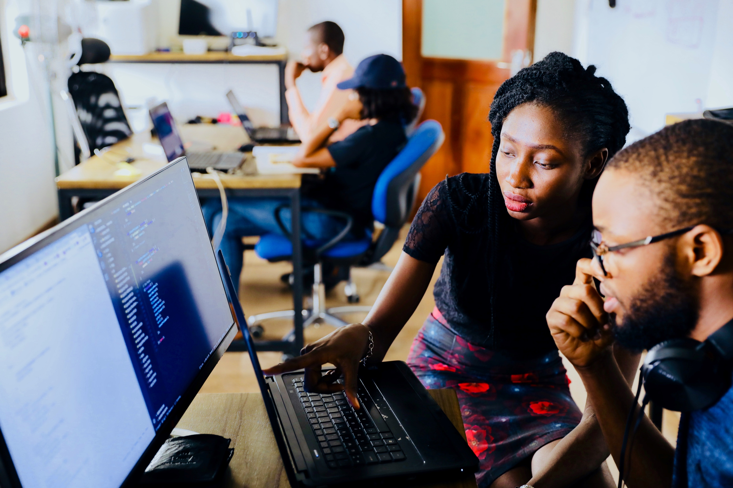
Photo by Mars on Unsplash
I’m a
PhD student
Scientist-in-training
Graduate TA
Self-taught R student
Coffee fiend
Notes:
I’ll start off by saying: the first time I really looked at someone else’s work critically, with a view to working together to improve on it, was as a graduate teaching assistant. And in that kind of situation, I have an idea of what to expect, the solutions people come up with, common pitfalls, and so on. And I really enjoy this kind of interaction.
In most everything else, I was only ever looking at the guts of other people’s work with a view to adapt it for myself. Any work I ended up producing was for my eyes only, in pursuit of valid results; and when I got to the presentation stage and shared the end product, for the most part, that’s all that people wanted. As long as I could tell people what I’d done, and justified it, no-one was bothered to cast a critical eye over my code.
So the first time I knew I would be working in a team, I was petrified. My first reaction was: great concern! Particularly as a self-taught R student. Without a formal education, I’ve just picked up things as I needed them. I iterate stuff until it works. Sometimes the scope changes. Sometimes the whole approach needs an overhaul. Efficiency is often an afterthought. I don’t know what I don’t know!

Slide 4

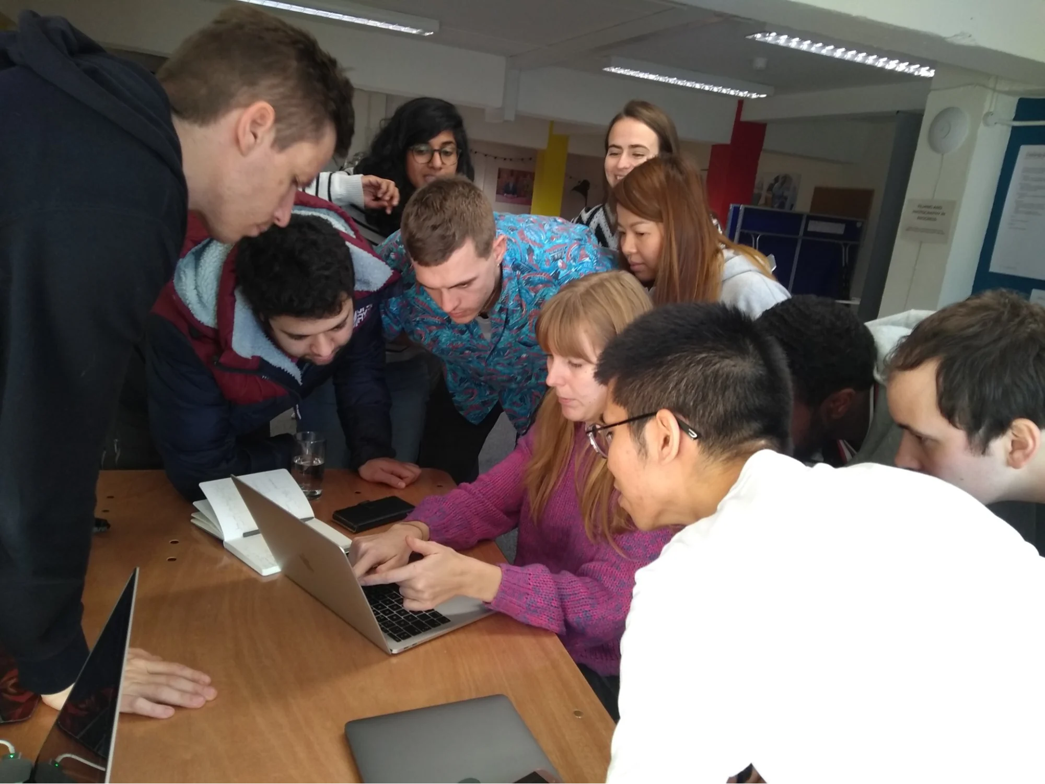
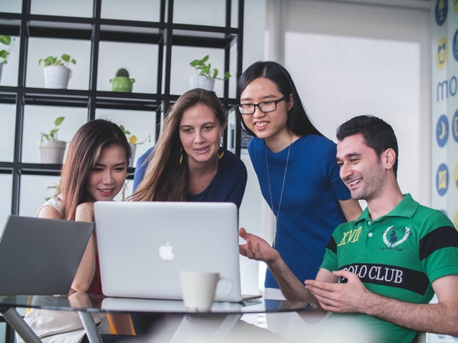
Using R by myself
Team management
Aligning expectations
Business goals
Learning to play with others
Photo by Mimi Thian on Unsplash
Photo by Avel Chuklanov on Unsplash
Notes:
So to go From Me to Team, I’d like to speak a little bit about my journey with R as an self-taught user, using it for work, and how that informed my approach to working in a team environment. What this isn’t: I’m not going to speak to managing a team of data folks here; there’s a lot of different ‘team techniques’ that have fancy names: pair programming, dojo, mob programming… my insight, such as it is, is much more localised: what it was like for me taking the leap from solo to teamwork.
A lot of what I’d like to share are essentially lighthouses that I wish I would have identified earlier in my own R journey. Some of it is also a bit of advocating for yourself in a larger environment, which I personally found intimidating at first. And lastly, I’ll share a little on some ways to dip your toes into collaborative spaces if you haven’t done so yet.

Slide 5
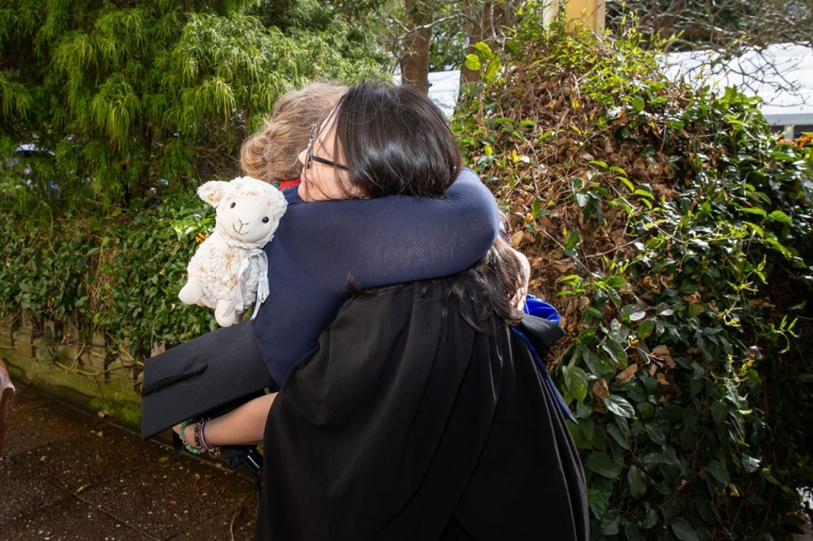
Herstory
Undergrad: no R involved
Research assistant: clinical trial
Data pipeline
Large amounts of data to play with
Needed R to get the job done
Masters: lots of signals to work with
Doctoral work: even more signals
Notes:
Starting with a little bit about me, and my journey into R. My undergrad was in pharmacology and physiology. All through undergrad I had no idea about R; rStudio was not released until after I completed my bachelors, and besides, I didn’t need any of that anyway. Any statistics and analyses that I did were simple enough to do by hand.
When I returned years later to take a research assistant position in a clinical trial, that all changed. Suddenly there was a real data pipeline, a bunch of data to wrangle and organise and analyse, and there was no way I could do it manually – I needed to use R to get the job done. I also used R in my masters, in data management and for investigating the presence of circadian rhythmicity in aspects of preterm fetal physiology data. This is actually a picture of me at my masters graduation, prematurely celebrating the return of a reasonable sleep schedule.

Slide 6
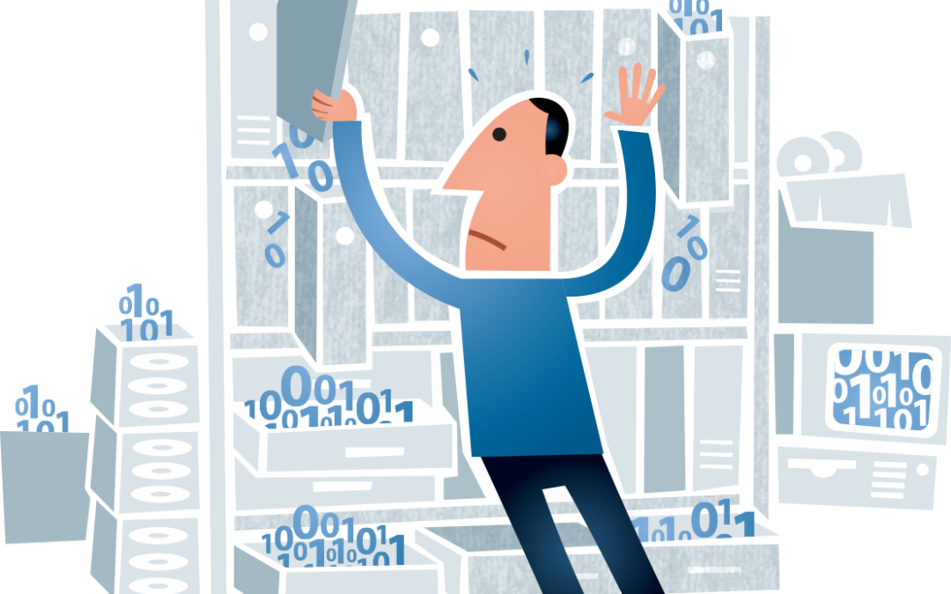
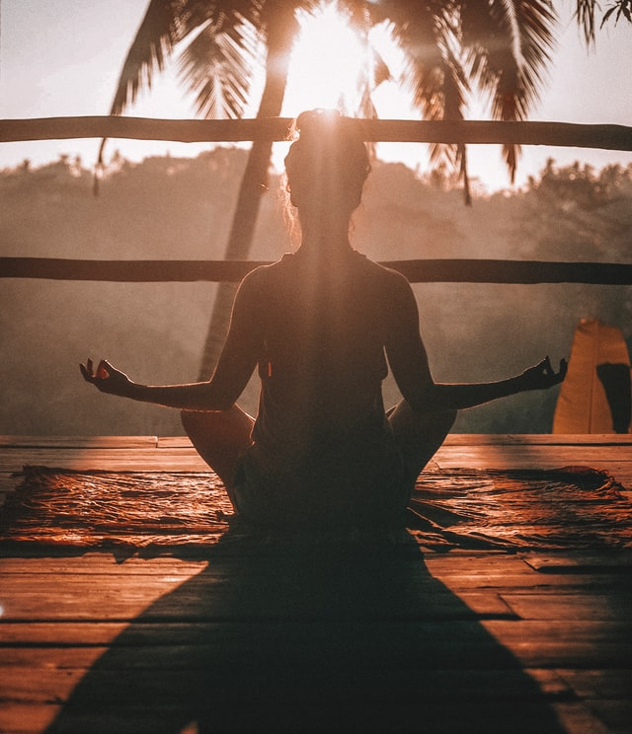
Bizprospex.com
Photo by Jared Rice on Unsplash
I’m a
PhD student
Scientist-in-training
Graduate TA
Self-taught R student
Coffee fiend
Notes:
And I have continued to use R in my doctoral work. my day to day activities are grouped into a few buckets: acquiring data in clinical/wet-lab work, conditioning and analysing data, writing it up and presenting it.
You can see that the main reason I first picked up R was out of necessity more than anything else: I couldn’t manage the volume of data by hand any more. These days, it’s not just the volume of data, but also the stuff I wanna do with it. In order to be a zen data master, a manual approach isn’t tenable any more. This picture isn’t me in front of my screen, but I do aspire to this state.

Slide 7
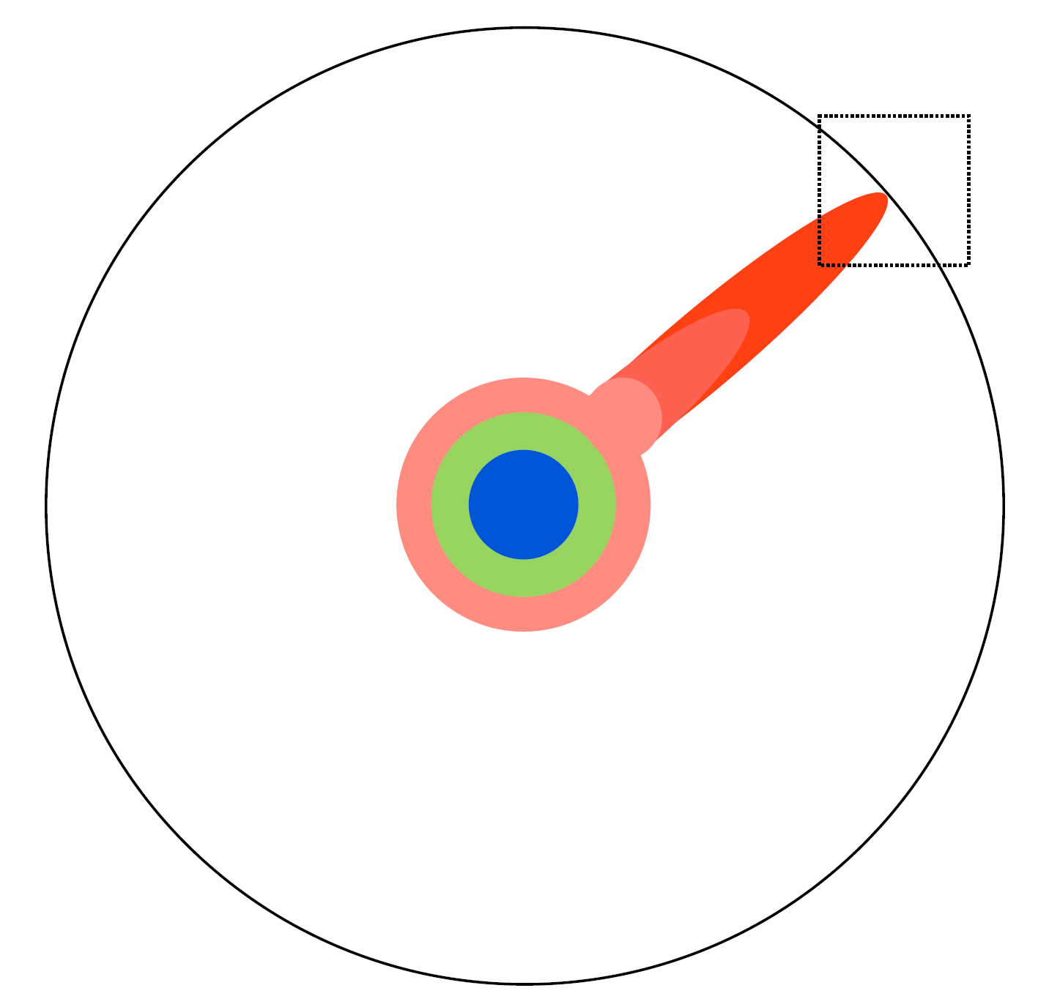
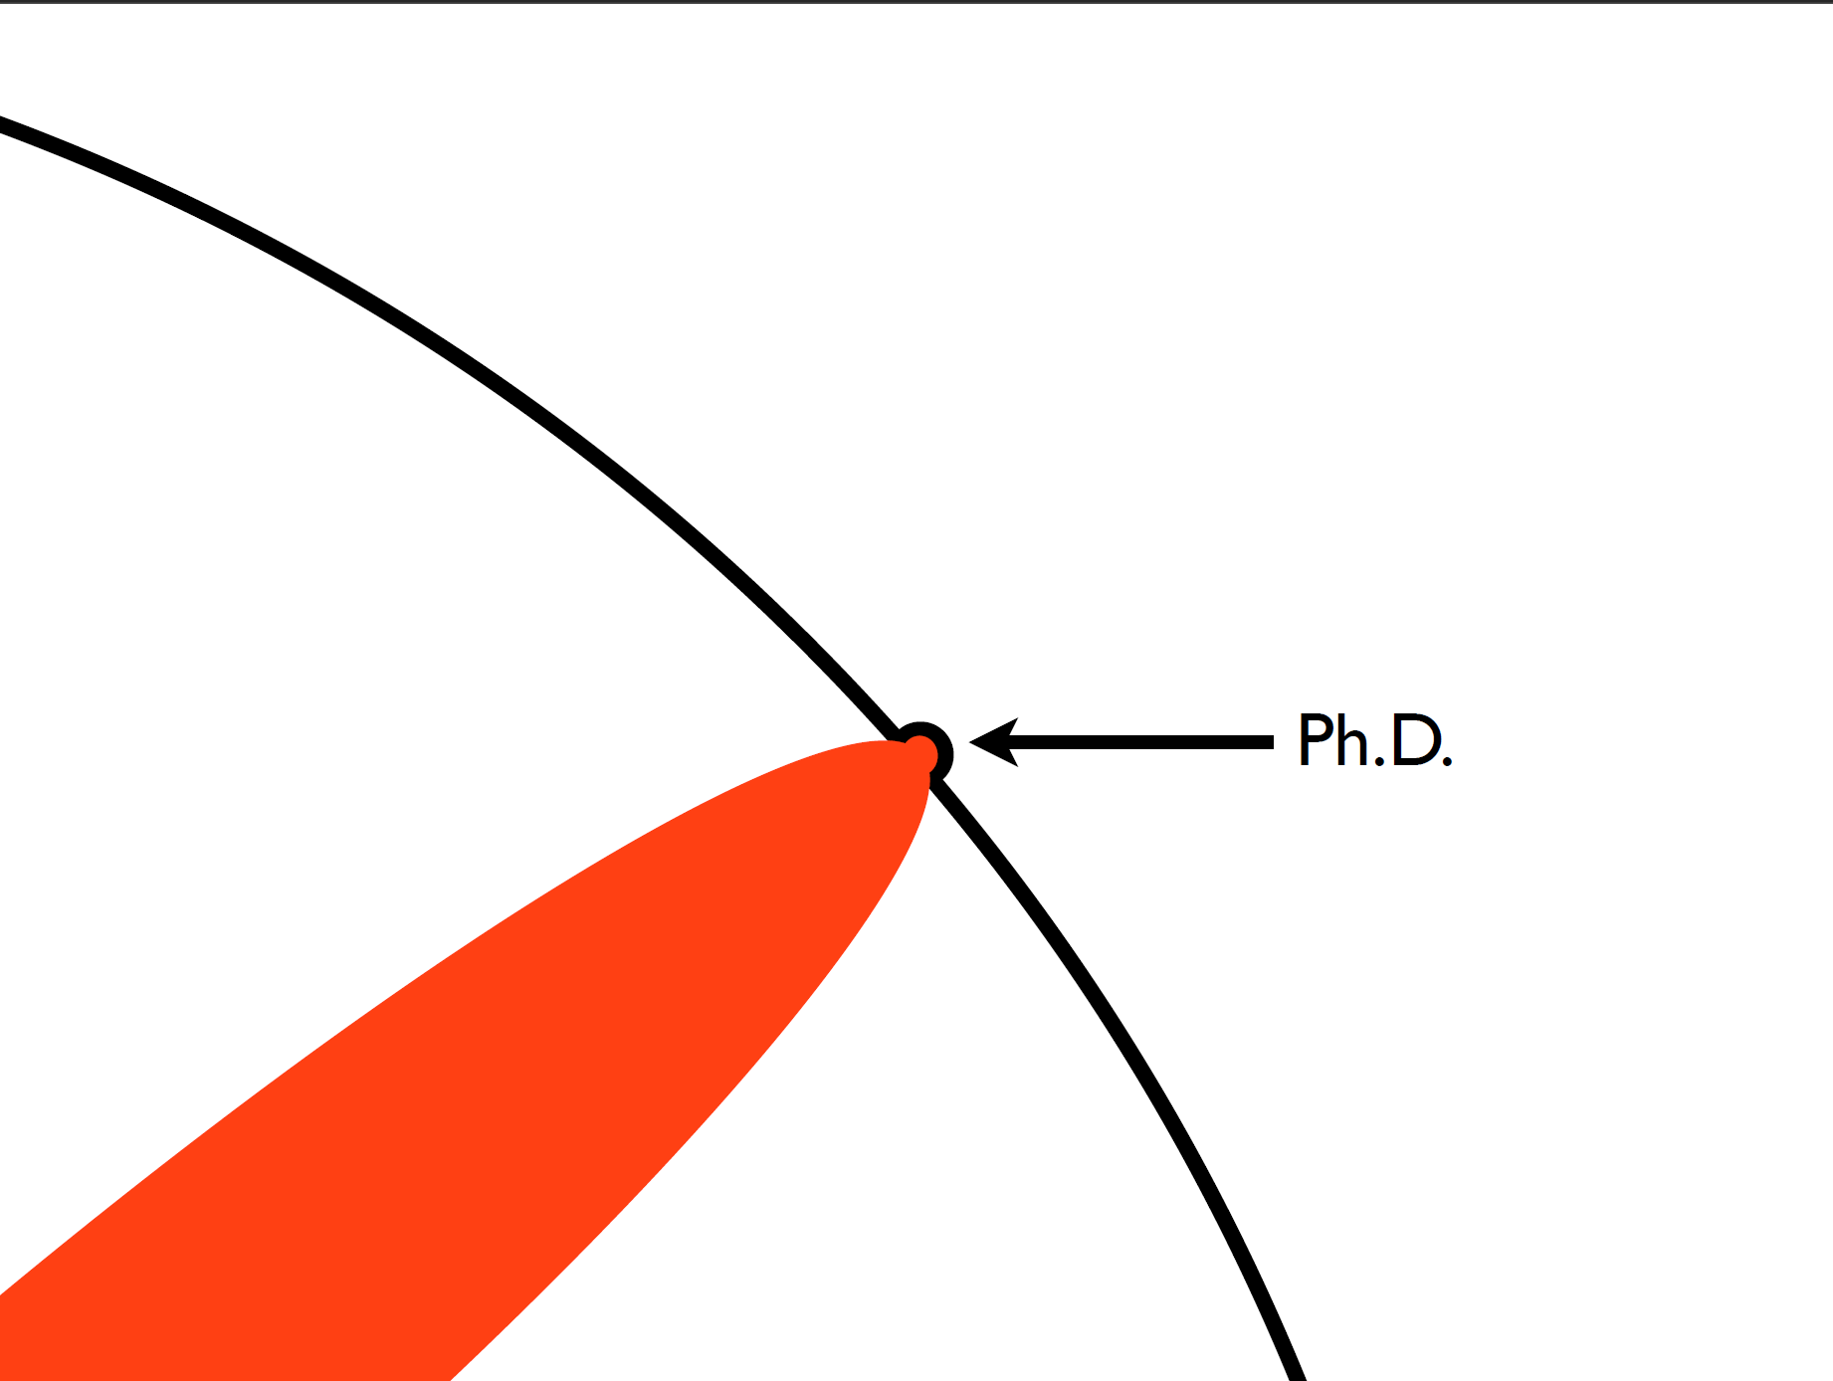
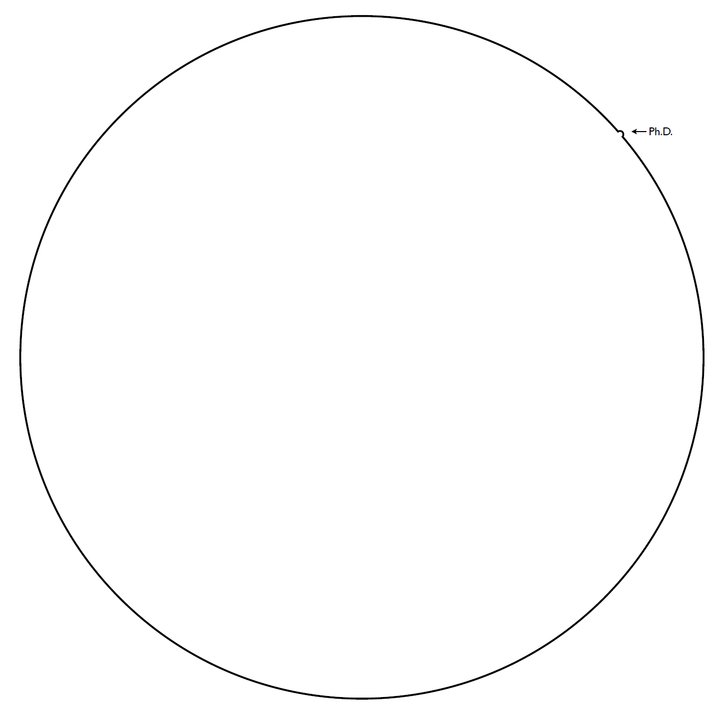
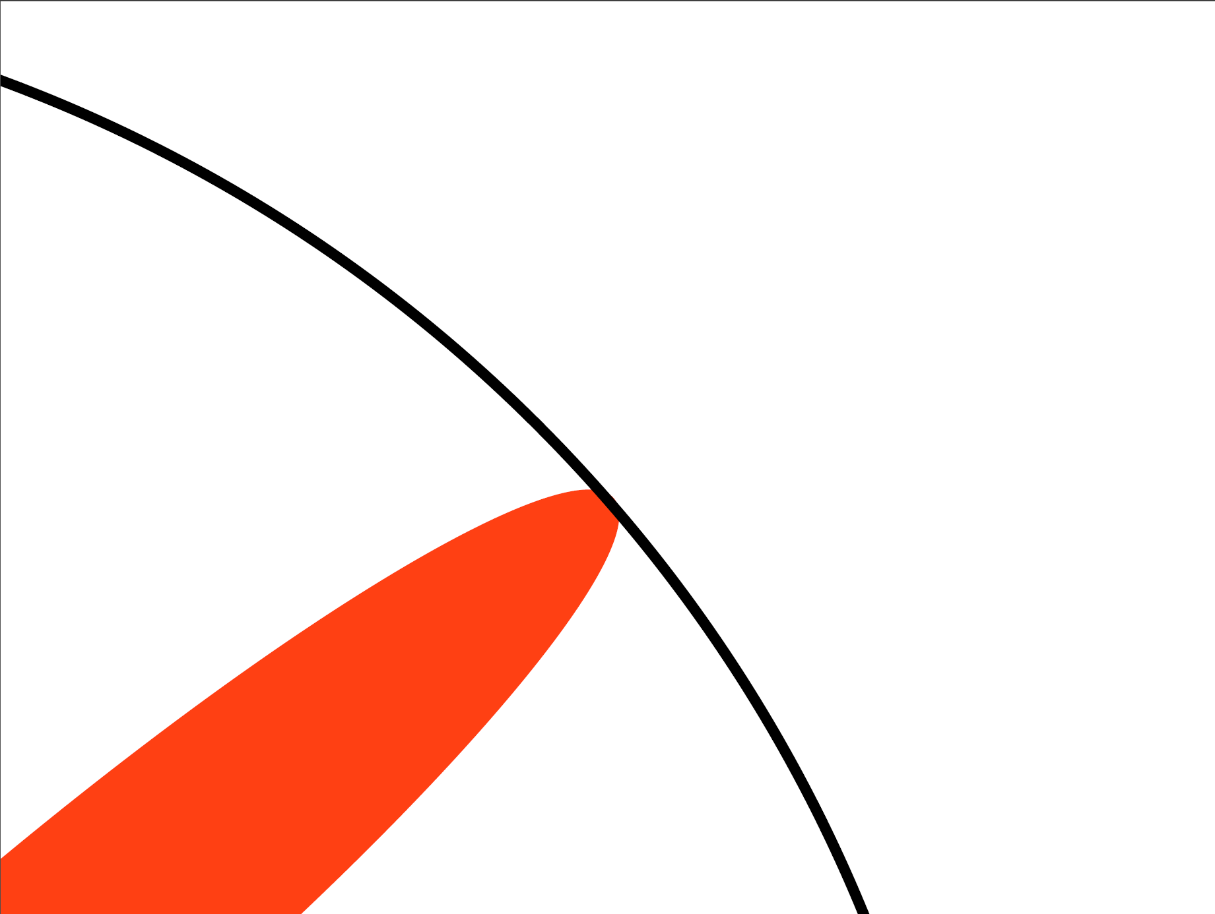
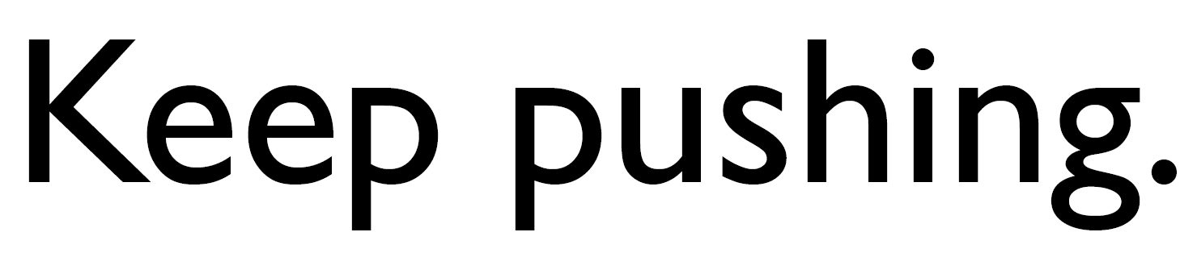
modified from The Illustrated Guide to a PhD
Matthew Might
http://matt.might.net
Notes:
Before I continue, I want to establish: I don’t want to come across as bashing on independent R use. I honestly think that works in lots of cases, and it certainly served me adequately for a long time, because a lot of the educational experience for me was highly individual. These pictures are adapted from Matthew Might’s Illustrated Guide to a PhD, where the circle represents the sum of human knowledge. The expanding coloured circles in the middle represent your education at various stages, and the red arm is the tiny, minute focus of a PhD. The whole point is that you are hammering a particular point of progress until it files. The work is meant to be novel, and compared with the whole circle of human knowledge, what you’re doing is relatively specialised. That usually means there’s not too many people doing the exact same thing you’re doing. And as we said before, most people are not as interested in the guts of how you got somewhere, as much as the implications of what you found.

Slide 8
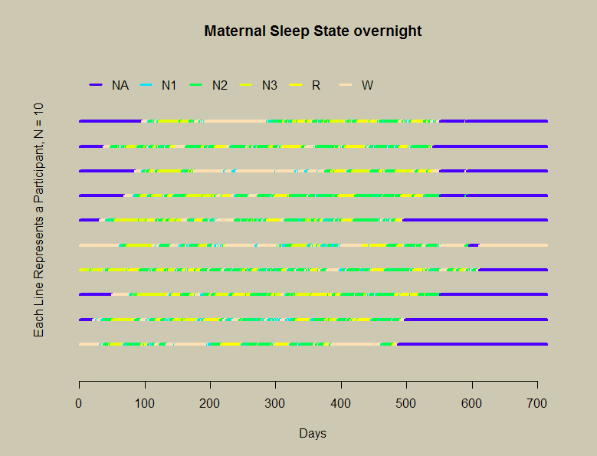
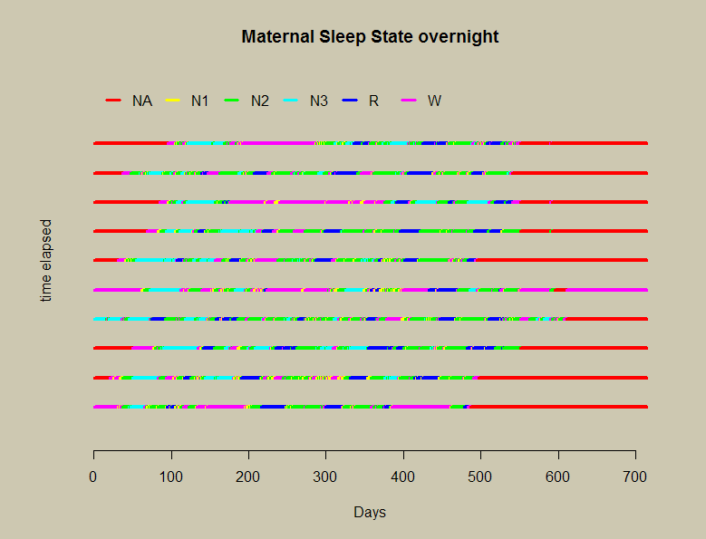
how it started
N = 10
midnight
longcatplot
Notes:
I think no matter what you’re doing, there’s pressure to produce results, and working alone, it’s very easy to make that the only goal. As an example, here’s a slide that I made at the start of my doctoral studies. I had an observational study with a bunch of sleep electroencephalograms from women in late pregnancy, a bunch of recordings of their brain activity during sleep. This signal data came from multiple channels per person, and this was combined, and in 30second epochs, scored into different sleep states across the whole recording. Your physiology is different according to different sleep states: for instance, N3 sleep is deep sleep associated with production of certain hormones; you might dream, but you won’t remember it. REM sleep is rapid-eye-movement sleep: this sleep is associated with memory formation. You’re more easily rousable, and this is where you have the dreams you might remember when you wake up. Having too much, or not enough, of a particular sleep state can affect your health; however, beyond “not enough of it”, we don’t really know much about sleep in late pregnancy, and even less about what it’s like for pregnancies complicated by various conditions.
So this was my first attempt at visualising maternal sleep overnight. I’d taken ten participants, colour coded their different sleep states (note the NA at the top, as I hadn’t yet figured out what to do with ‘uncategorised data’) and represented them on separate lines. The colours are horrendous, I’m missing a proper clock time axis. But it was enough to get me going in the right direction. This kind of visualisation has promise. So I kept trying things, adding stuff, iterating on it…

Slide 9
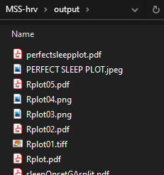
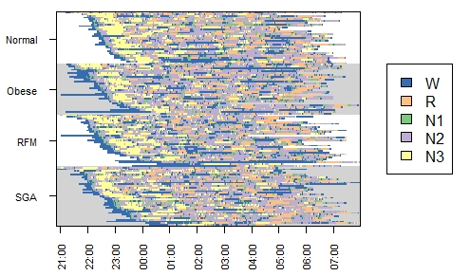
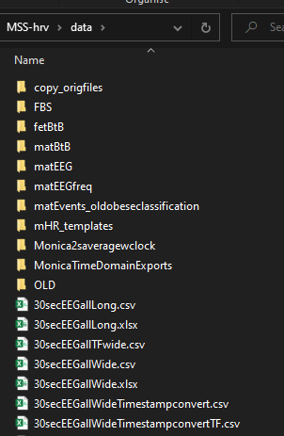
how it’s going
lasagnar
Notes:
And this is what it eventually turned into: the sleep staging of 130-odd women, stratified by ‘lights out’ – the time they attempted to go to sleep – and separated into different pregnancy complications. This grouping allows us to see whether there is a relationship between the maternal sleep staging in late gestation pregnancy, and different pregnancy complications.
There are some interesting points raised by this – the immediate implication is that the amount of sleep and sleep stages, and their timing, are not different among pregnancy groups. This leads us to explore other aspects of this observational study: sleep staging is a time-domain approach to sleep quality; perhaps we could look at what kind of frequencies are contained in those sleep stages. Or perhaps we might look at the respiratory events (so, think things like sleep apnea) occurring overnight – such events are supposed to be more likely in certain sleep stages, so we could investigate their timing in these women.
OK, we’ve got our output, and a handle on the implications. We’re done here, right? Well, sure, we could be. But what if someone wants to re-run the analysis? This is an observational study; what if someone wants to add another group someday? In that case… [click] maybe we’re not done. Because this is what was underneath that. I wish I was making this up.

Slide 10
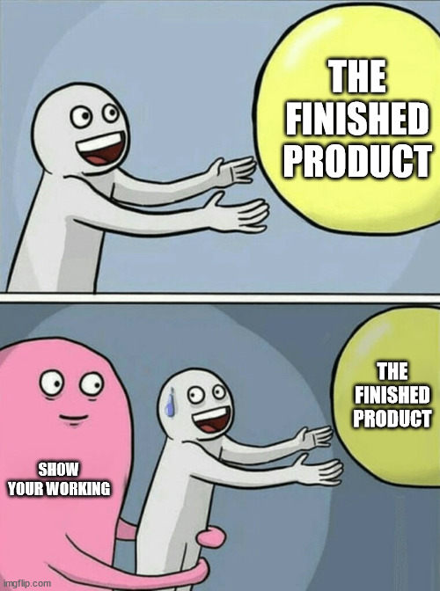
being ready to share
It’s scary, but we can try!
“Dirty code is better than no code”
Data may not be shareable; code is less identifying
The Community Research and Academic Programming License
Invite feedback!
prepares us for working together
Notes:
So the first time I had to share the guts of my work – scripts and so forth – with anyone, I felt very vulnerable. And while that particular experience might be unique to me, I don’t think that feeling of trepidation is particularly unique.
And at least in science, there are more and more reasons for sharing. The open science movement is sometimes summed up as ‘open source, open data, open access, open notebook’, which can sound a bit trite, but a fundamental goal of the is achieving transparency in experimental methodology, observation and data collection. Being ready to share is one way to work towards that goal.
In particular for me, where work sometimes involves medical data, the raw stuff may not be sharable, even if anonymised. There are lots of factors to consider when we think about open science, including privacy, reverse identification, consent, and data sovereignty, particularly for example in data involving tangata whenua. In these cases, I think making the code available when the results are disseminated, is a way to increase transparency.
Using tools like Rmarkdown can help you make a finished product that can also show your working, I think Jacquie Tran has spoken to Rladies about using Rmarkdown before. And I think the principle of being ready to share remains the case even when you have something you’re not especially pleased with – it might not be the cleanest, best commented code, but it’s probably better than nothing at all. Matthew Might came up with the Community Research and Academic Programming License, which has a self-descriptive acronym, and the attitude behind it is very reassuring. Matthew says that it ‘absolves authors of shame, embarrassment and ridicule for ugly code’. Lots of work is glued together on a sharp deadline; there’s often a lot of ‘proof of concept’ type stuff and the edges can be a bit rough. But, when I want to, say, evaluate my research with respect to someone else’s research, I am grateful for even a sketchy implementation to be included in the supplementary materials of a publication or release.
I think Emma Vitz, who has also spoken to R-ladies before, has espoused the benefits of sharing – one of which is you get feedback, from experts and non-experts, and it all helps you improve. R is a really popular language, and while R has a million packages and functions that might do exactly what you need, if you don’t know about them, you can’t use them. The R community is super friendly and I think this is an advantage that’s really hard to overstate.
Ok so that’s a a case for sharing stuff, but what’s that got to do with working in a team? The point I want to make here is that being ready to share is the first step to working with others. Showing people how the sausage is made is a way to become more comfortable with cooking with others. So since we know there are now compelling reasons for us to be prepared to ‘show our working’, we now need to know: who are we showing it to? Who are we gonna be working with? As we’ve said, most people are interested in the final output, and there are packages of R all over the internet with tutorials, vignettes and instructions. Everyone knows everything. We’re covered now, right?

Slide 11
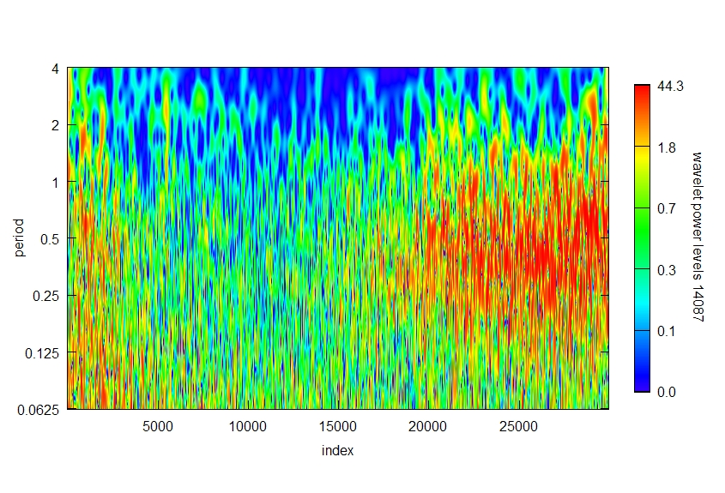
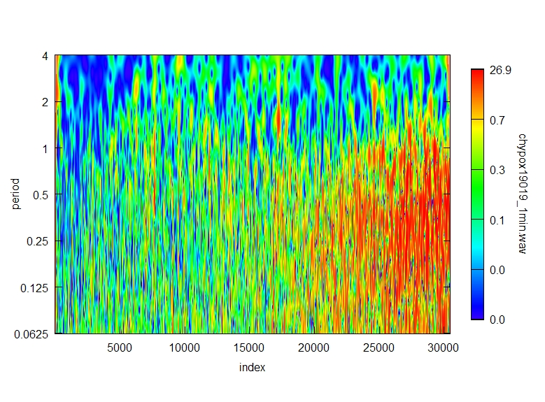
know your audience
1min averages
4h
high power
2h
1h
normal
30min
15min
8min
low power
4min
4h
2h
high power
ongoing oxygen insufficiency
1h
30min
15min
8min
low power
4min
~mid
~term
Rwave
WaveletComp
gestation
Notes:
Well, to illustrate this point, I’d like to use another example to hopefully demonstrate the importance of knowing your audience. These pictures here are the results of another EEG analysis, a different study, which is ongoing. Don’t sweat about exactly what it is too much, it’s not too important. It’s essentially a representation of fetal brain activity. We get filtered recordings from two channels and normalise the data. We then perform a wavelet transform for a time-frequency analysis, and this representation is visualising the periodicities present in the recording taken over a number of days. The top panel is data from a normal pregnancy, and the bottom panel is a pregnancy affected by chronic hypoxia, which can happen in some cases of growth restriction.
So this is a way to visualise the development of different kinds of brain activity during this point in gestation, and we can see that the trajectory is different between the two pregnancy cases. This might be of interest for the investigation of brain activity during this period, and perhaps eventually aligning it with other measures like, say, heart rate.

Slide 12
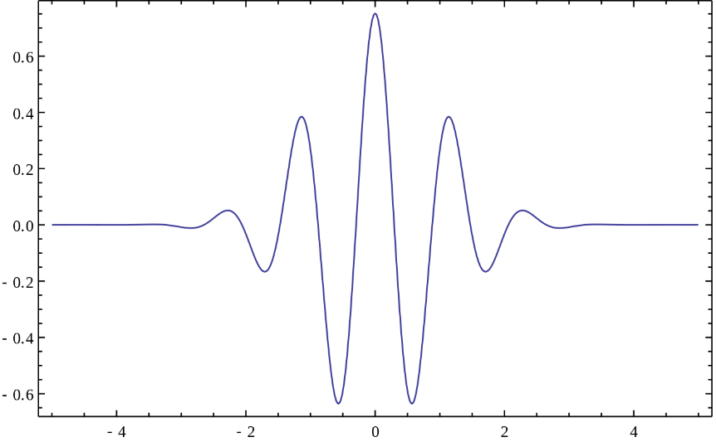
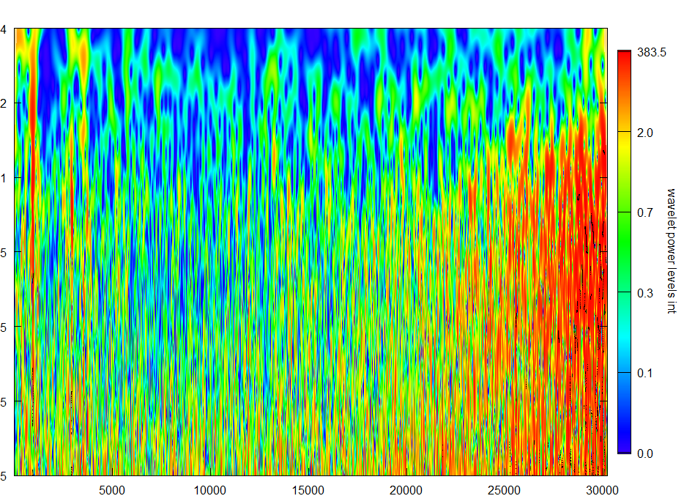
Methods
Clarity
in your intentions, if not your code
Clear documentation
that all interested parties can understand
Comments
detail helps ☺
Credit where it’s due
Morlet wavelet transform
Angi Roesch and Harald Schmidbauer (2018)
wavelet power spectrum
Notes:
And this is the slide I used to explain my analysis methodology when I was presenting the work.
And for the audience I was trying to convince at the time, it does the job that it needs to! We have a signal, I use wavelet transform, we get a picture that we can interpret. Done.
More broadly, though, there’s more than one audience for the work. The end picture and its interpretation are of interest to other physiologists and perhaps clinicians. Implementing the wavelet transformation technique might be interesting to physiologists and other signal scientists. Getting the filtered, conditioned signal data in the first place, and then into the right format to perform the technique might be important for other people who acquire this kind of EEG data. So when I was asked these questions, it became obvious that I was going to need to be as clear as possible about as much as I could of what I was doing. Your audience – the ‘team’ you work in – may not necessarily be directly contributing to your code, but they still need clarity on what’s going on and how to use it.
[click] So when I’m writing now, I try to keep in mind: who is your audience for this? Who needs to read it? And this extends beyond just the code itself: stuff like having a readme that everyone agrees on, that everyone understands, with really clear instructions on as much as possible – from installation to output – shows empathy for others working with you, in whatever capacity.
Carrying this kind of attitude also leads to adequate commenting. One of the really excellent things about R, in my opinion, is that it’s fairly human readable, so this can do a lot of the heavy lifting for you. Even still, I tend to fall on the side of ‘more comments are better’. So comments not just about what a piece of code is achieving, but why it needs to happen. The kind of detail you include is gonna be different depending on your project, and I don’t want to sound prescriptive here. I would say that more documentation is rarely irritating, but can be really helpful for someone who might be new to this field or aspect of research, or someone who might try to adapt your implementation for something else.
As well, I think aspiring to the principle of clarity is a great way to ensure you can credit work appropriately. Obviously, the whole point of collaborating is that the eventual full output is a team effort, and will be attributed as such. But, if there’s something that you are expert in, or contributed to in a specific way, having clear documentation and code that you can point to later is really helpful, and can help you make your case for joining a future team project.

Slide 13
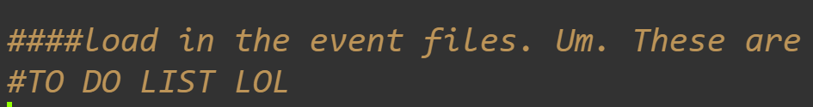
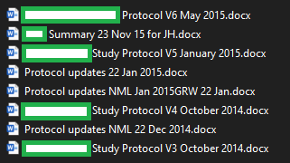
Photo by Carl Beech on Unsplash
know their needs
Notes:
Another aspect of knowing your audience is knowing their needs. I’d like to relate a lesson I learned in my first team environment, which was a clinical trial. When I first joined, I was essentially given free reign to iterate and try and improve upon most aspects of data management. This was really exciting for me, and I like to think I eventually got it down to a lean efficient machine. What I hadn’t initially appreciated, though, was that as more people would be joining me in the data management process and contributing to the pipeline, from a variety of different disciplines, we would need to agree on an approach. Crucially, any approach, as long as we kept it consistent.
[click] I realised that at some point, it became counterproductive to be ‘improving’ things. The desire to perfect something, to make it work ‘better’, even just to test an idea – not always helpful. Sometimes, you make things more difficult. And while I love coming up with approaches and analysis techniques, it was in my own interest to immediately accept that I’m not the only one with ideas, and there’s lots of different ways to achieve something. Whatever it is that you want to do, whatever it is that you need to achieve, in a team, I’ve found it’s more important point to do so in a consistent manner, in a way that everyone can get on board with. In my experience, one of the ways to optimise for consistency was to minimize opportunity cost. That is to say: do what you're best at doing, and partner with specialists and engage other people when you need to do something else. That’s why you’re in a team together. I think that this is the hardest principle for scientists and engineers to accept. We feel that if we can do something, we should. But everyone benefits when we can accept that and have horses for courses.
Of course, the counterpoint to rigid consistency [click] – is that sometimes you just need to make the case for changes, and justify doing thing differently. Something that I personally found useful which kind of follows on from earlier, and maybe this applies particularly as a woman, or maybe if you were a young person – knowing I had examples of my credentials or skills in a particular area that I could lean on, and point to, helped to lend credence to some of my contributions. Now, I think the gender balance, and minority balance, that kind of thing, in a lot of places is improving, which is awesome, and no-one should ever be needing to ‘proving their worth’ – that shouldn’t be the point here – there’s a reason you’re working together in the first place. But having these examples in my back pocket was both a confidence booster for myself, and helped others I was working with have confidence in my ideas. So regardless of whether you should need this backup, at least for me it was a nice thing to have available, especially when I first started working with others.

Slide 14
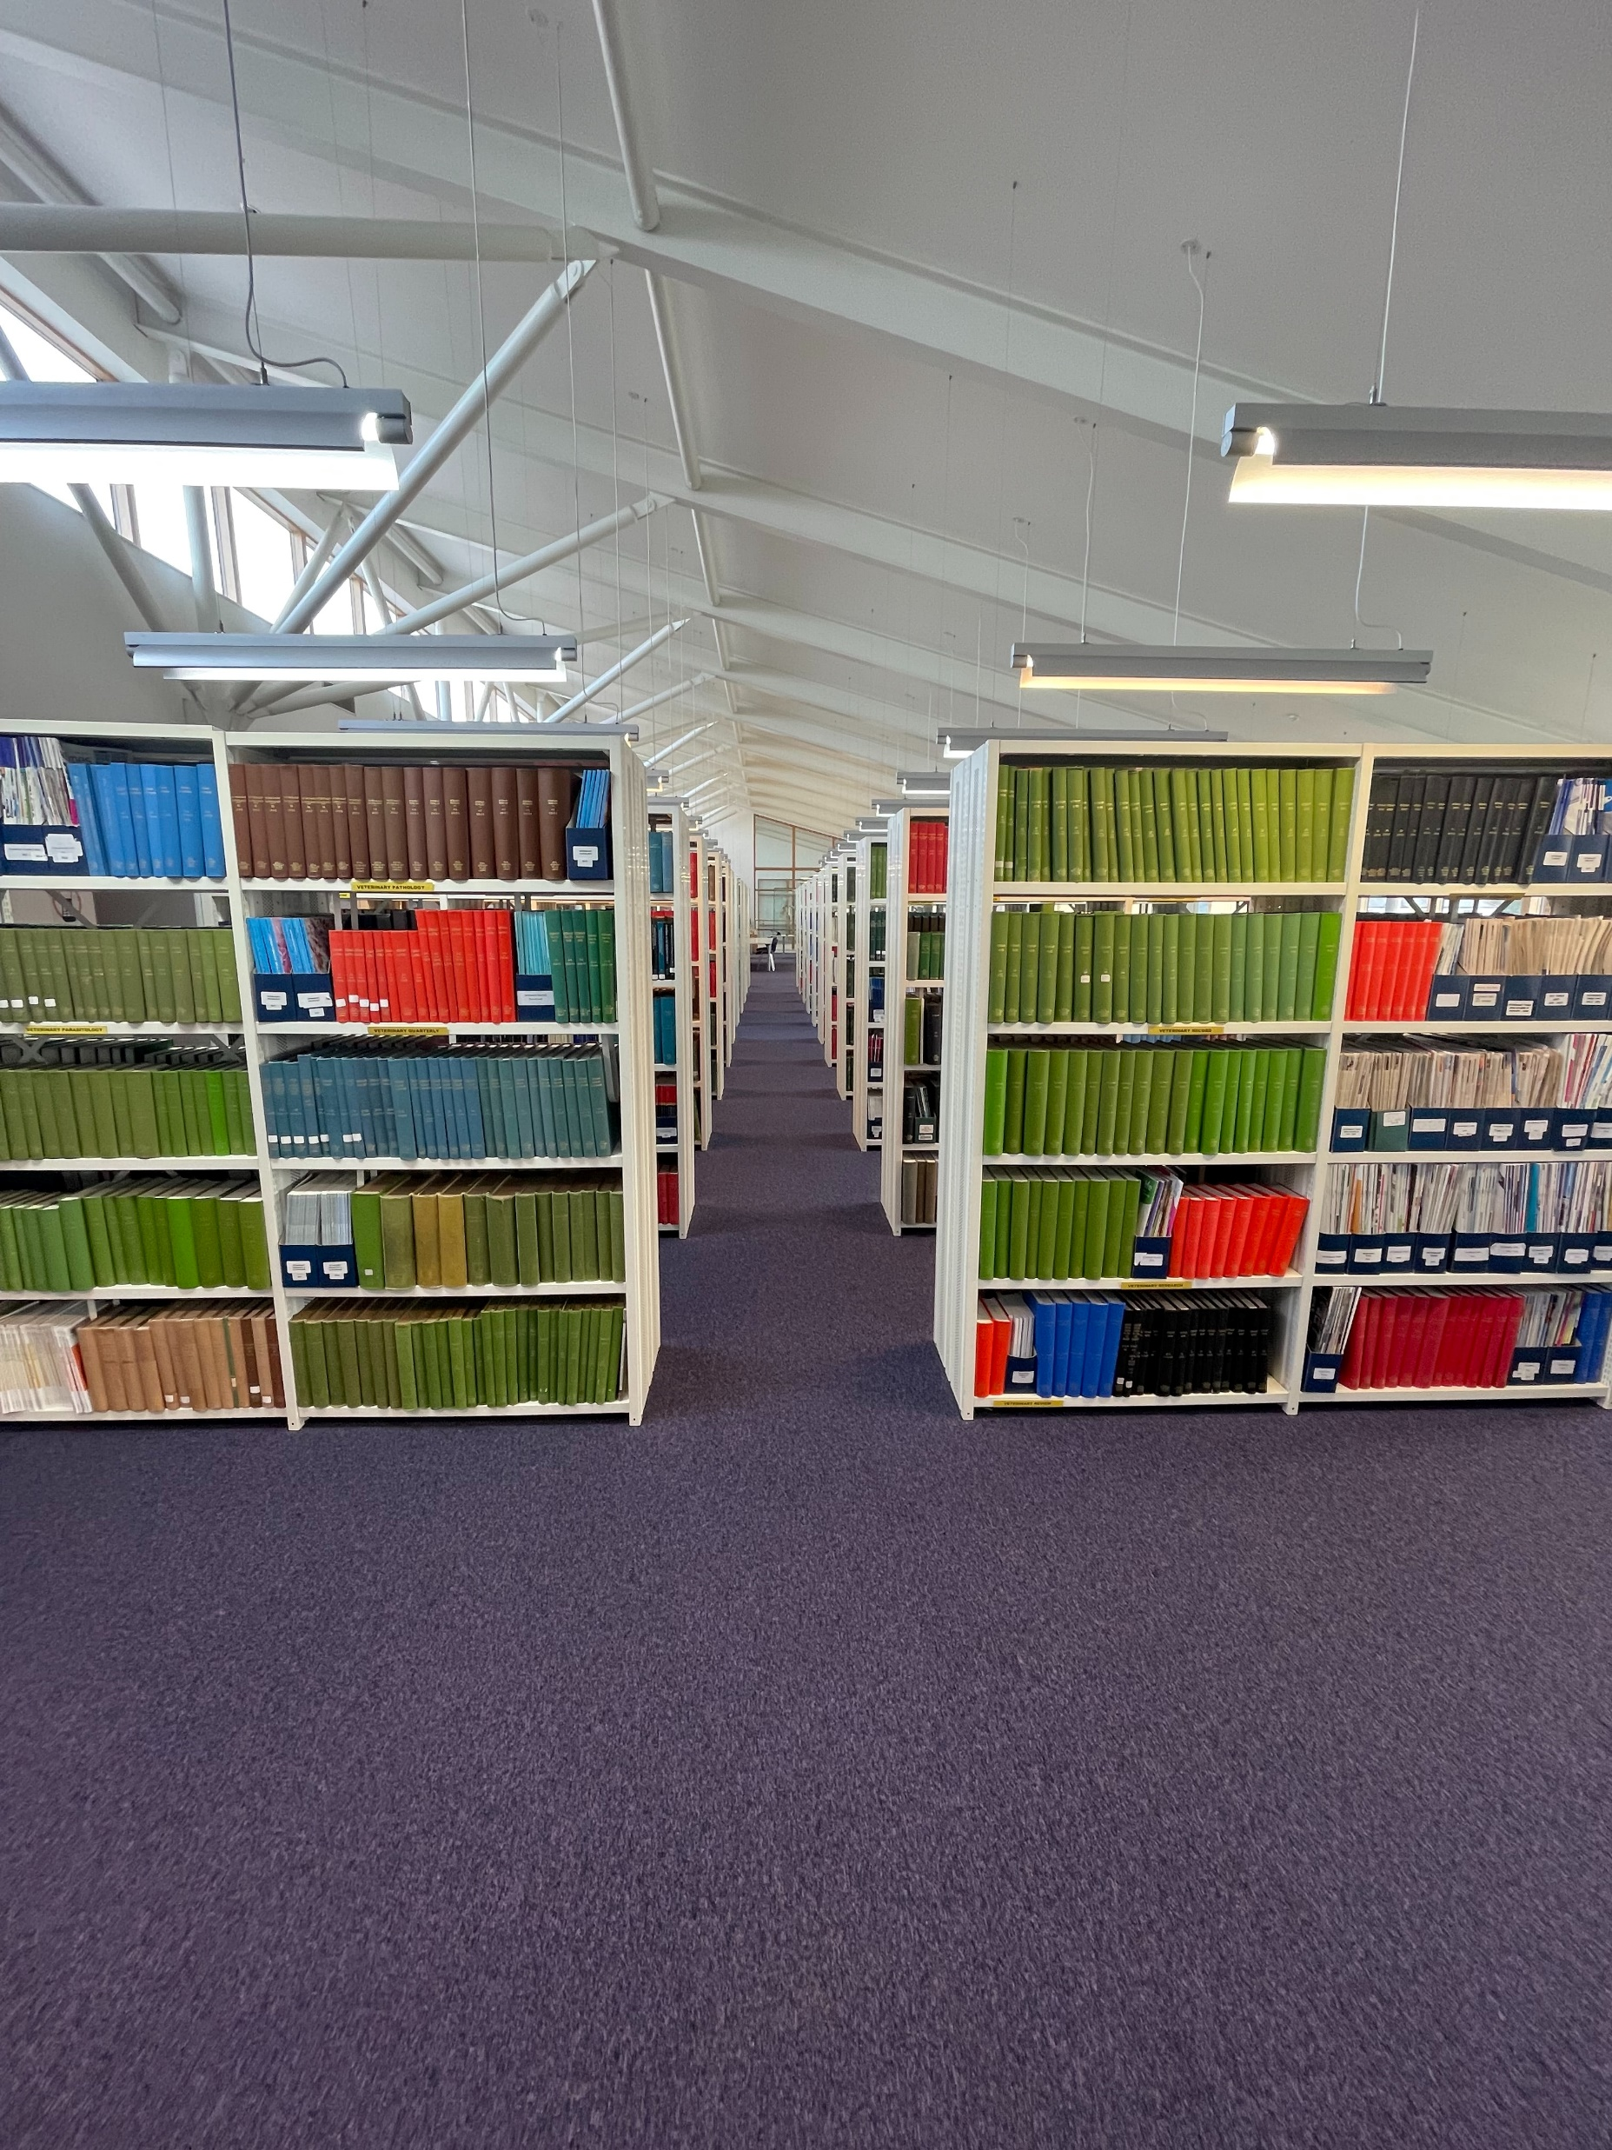
Photo by Carl Beech on Unsplash
know their needs
Consistency
Perfect is an aim, not an outcome:
Done > Perfect
Consider goals and timelines
both yours and your colleagues
Horses for courses
… sometimes there is a case for change!
Notes:
Another aspect of knowing your audience is knowing their needs. I’d like to relate a lesson I learned in my first team environment, which was a clinical trial. When I first joined, I was essentially given free reign to iterate and try and improve upon most aspects of data management. This was really exciting for me, and I like to think I eventually got it down to a lean efficient machine. What I hadn’t initially appreciated, though, was that as more people would be joining me in the data management process and contributing to the pipeline, from a variety of different disciplines, we would need to agree on an approach. Crucially, any approach, as long as we kept it consistent.
[click] I realised that at some point, it became counterproductive to be ‘improving’ things. The desire to perfect something, to make it work ‘better’, even just to test an idea – not always helpful. Sometimes, you make things more difficult. And while I love coming up with approaches and analysis techniques, it was in my own interest to immediately accept that I’m not the only one with ideas, and there’s lots of different ways to achieve something. Whatever it is that you want to do, whatever it is that you need to achieve, in a team, I’ve found it’s more important point to do so in a consistent manner, in a way that everyone can get on board with. In my experience, one of the ways to optimise for consistency was to minimize opportunity cost. That is to say: do what you're best at doing, and partner with specialists and engage other people when you need to do something else. That’s why you’re in a team together. I think that this is the hardest principle for scientists and engineers to accept. We feel that if we can do something, we should. But everyone benefits when we can accept that and have horses for courses.
Of course, the counterpoint to rigid consistency [click] – is that sometimes you just need to make the case for changes, and justify doing thing differently. Something that I personally found useful which kind of follows on from earlier, and maybe this applies particularly as a woman, or maybe if you were a young person – knowing I had examples of my credentials or skills in a particular area that I could lean on, and point to, helped to lend credence to some of my contributions. Now, I think the gender balance, and minority balance, that kind of thing, in a lot of places is improving, which is awesome, and no-one should ever be needing to ‘proving their worth’ – that shouldn’t be the point here – there’s a reason you’re working together in the first place. But having these examples in my back pocket was both a confidence booster for myself, and helped others I was working with have confidence in my ideas. So regardless of whether you should need this backup, at least for me it was a nice thing to have available, especially when I first started working with others.

Slide 15
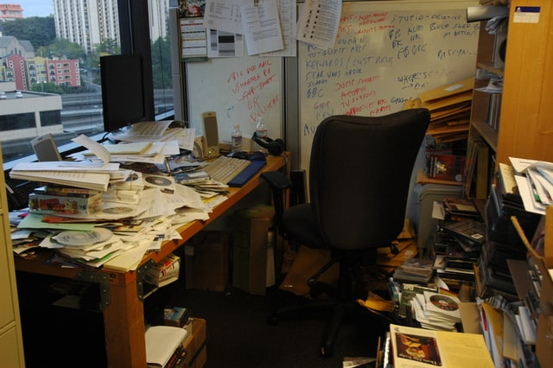
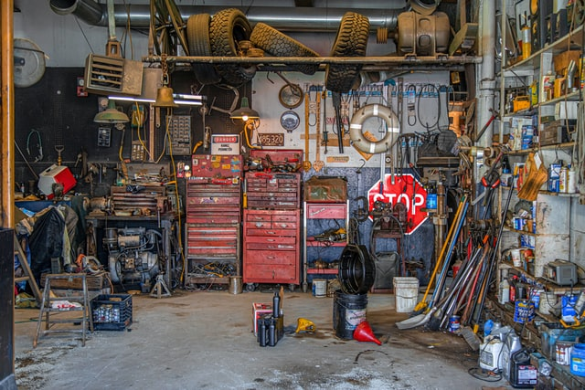
Photo by Wonderlane on Unsplash
Photo by todd kent on Unsplash
Empathy
Clarity and consistency go a long way ☺
Review can be uncomfortable
Remember the effort and the person behind the screen
Cite sources for learning
Empathy
Clarity and consistency are good ☺
Notes:
All these experiences are coming together in my involvement in a larger project on fetal heart rate and heart rate variability. It involves a lot of people, from a lot of different disciplines and different backgrounds. Particularly in challenging hybrid-remote settings, good communication has been extremely important for everyone.
I’m still in this project, and my main takeaway here has been kindness. When I work by myself, it’s really easy to make it make sense to me, and it doesn’t matter if my office gets messy, I will worry about tidying up later. But as we’ve already seen, this is not a kindness to myself. [click] When I’m working with others, it’s less ‘my office’ and more like a garage workshop. Yes, we can accept it will get untidy, but we all need to extend each other the courtesy of keeping the place functional for everyone. To that end, the principles of clarity and consistency go a long way.
[click] I’ve also found kindness to be really important in a code-specific aspect of working in a team. Looking at other people’s work, and other people reviewing yours – it’s really important to engage with empathy. This is something I draw on from being a graduate teaching assistant; I try and remember that I, and others, put a bunch of effort to write the work that’s being reviewed. And not everyone is working ‘in their native language’, so to speak. So I try to be as specific as I can when I have questions – down to the function, down to the lines. If I think something might benefit from retooling, I might make suggestions, but I’ll also try and cite some sources. And while sometimes it’s a paper, it’s not always like ‘formal fancy education material’ – sometimes a video demonstrates my thinking better, and I’m pretty sure someone has linked me to a podcast before. If we do this, in this way, I get given an opportunity to learn both a technique and a way of thinking, which is awesome, and that’s one way we can benefit from all the different ways our brains work, which is one of the best things about working in a team.

Slide 16
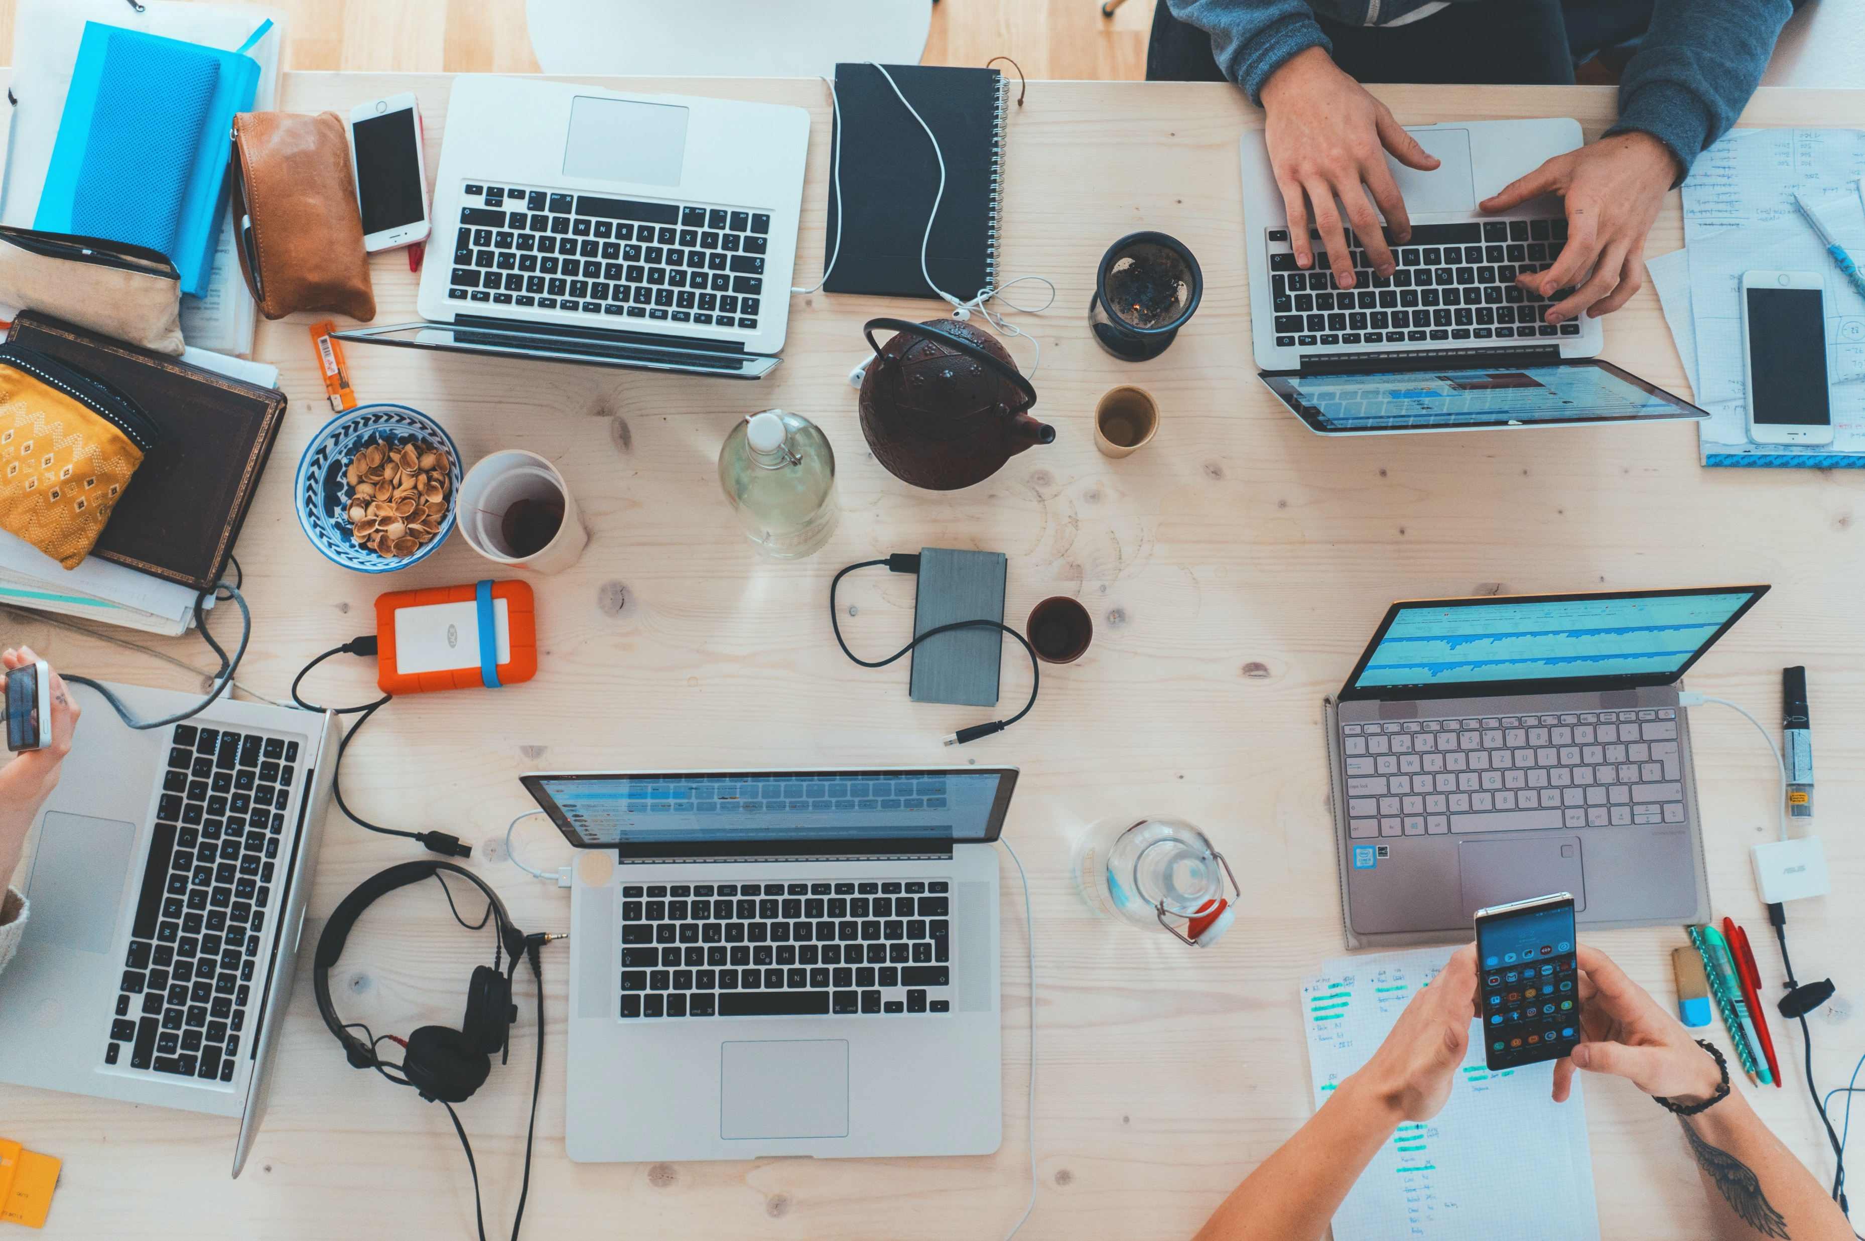
Photo by Marvin Meyer on Unsplash
modified from The Illustrated Guide to a PhD, Matthew Might
Ways to collaborate
Hackathons and meetups
Read other people’s work
Collaborating is not just contributing code!
documentation
modify a wiki
Notes:
I realise that a lot of this is fairly science-centric, and that not all of this is accessible or applicable to everyone, so I just wanted to end by putting forward some other practical ways to dip your toes into team environments if you want to start.
In the before times, group sessions and hackathons were helpful for me; the very first R-ladies event I attended was a session where we split into groups and played with some tidy-Tuesday data. Obviously in the now times, hackathons and group gatherings have other factors to consider in attending, but I think it’s important I mentioned them, and I’m hopeful that they can make a return when it’s safe to do so.
In the meantime, creeping other people’s work can be really illuminating. Read around and ask yourself what’s easily readable? What’s easy to understand? What makes something accessible? Poking around at publications and supplementary material was helpful for me, in the space that I work in, but looking on Github can be just as insightful. Github often moreso, as it has the advantage that you can see what other people consider issues, and follow the back-and-forth as people exchange ideas. And of course, you can suggest changes on Github as well!
Lastly I’m going to repeat a tip from Siouxie Wiles: there’s lots of different ways to collaborate. If you’re not sure about code additions, remember that contributing and collaborating is not restricted to code. The clinicians I work with gave me important pointers – that kind of thing often ends up in documentation. Making work more accessible allows more people to use it and contribute to it. Suggesting and contributing updates to documentation usually brings greater clarity and understanding, um, you can better articulate how to use the work. And ultimately, [click] that’s why any of this is happening in the first place – yeah, it’s kinda cheesy, but we want to use the work to produce meaningful outputs and together, as a team, make that circle bigger.

Slide 17
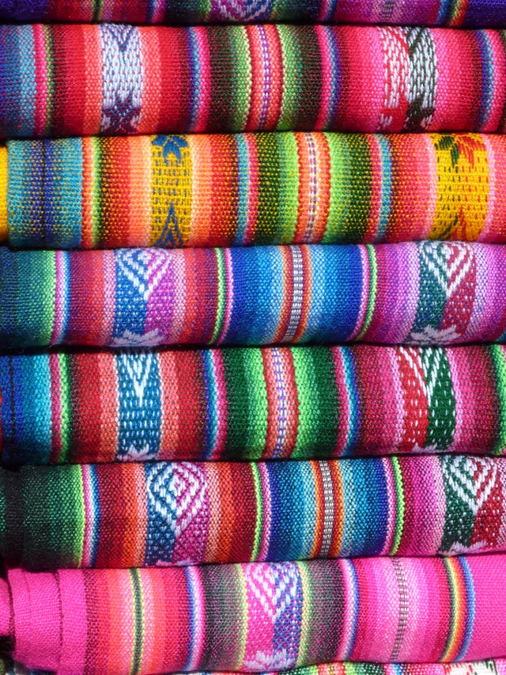
From Me to Team
Photo by Chris Bai on Unsplash
The CRAPL
Matthew Might
http://matt.might.net
“Dirty code is better than no code”
Lisa De Bruin osf.io/4i578
Everything Hertz episode
Solving the Path Problem:
Edwin Thoen
Learning to code collaboratively
Victoria King
@victoriaj_king
Notes:
So thanks for listening ☺ I just want to mention that these slides contain unpublished work, so the code for them is not yet public! However, the publication plans include code.
I’ve put a few links here I found really helpful, but since we’re on zoom, I can pop them in the chat now… or if you search on the internet for these people and terms they should pop up for you. That’s my journey from Me to Team; thank you so much for coming. And I guess this is where if anyone has any questions, I’ll do my best to answer them ☺
Lisa de Brian

